Slide 1

USING MAIL MERGE TO CREATE LETTERS IN MICROSOFT WORD
PRESENTED BY GROUP NINE MEMBERS.
ADENTWI EMMANUEL
ASARE MICHAEL
ARHIN PHILIP ROGER
PEPRAH KINGSFORD
OSEI ASIEDU KENNETH
VILLARS MARY ADWOA
AWUAH CHARLES
ETSUAH KINGSLEY KOBENA
KYEREMEH TABIRI HARRISON
FOSU TABITHA OFORIWAA
AMUNI NICHOLAS WISDOM

Slide 2
Mail merge
Mail merge is a feature within most data processing applications that enables users to send a similar letter or document to multiple recipients. It enables connecting a single form template with a data source that contains information about the recipient’s name, address and other predefined and supported data
The mail merge process involves the following: 1. The Main Document 2.Data Source
The Main Document – contains the text and graphics that are the same for each version of merge
Data Source – a file that contain the information to be merged into a document. The name and the addressed of the recipients of a letter

Slide 3
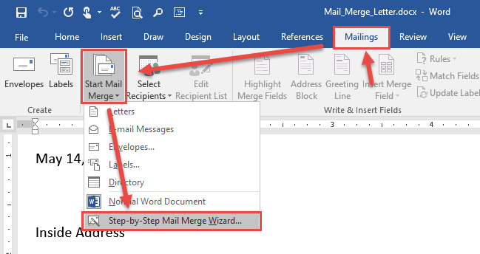
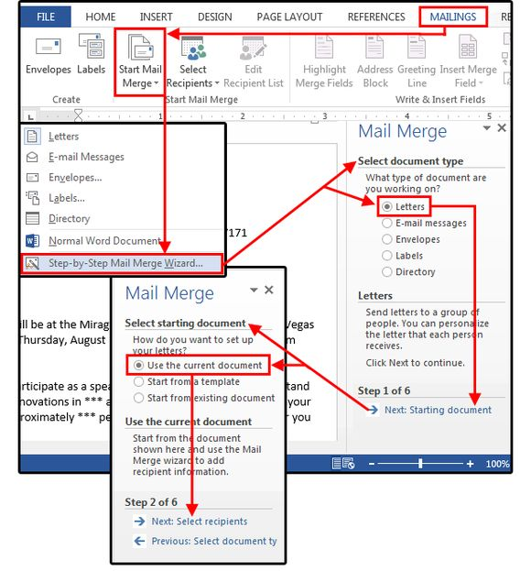
Steps to open mail merge-(form) letter
Open MS Word and create a new blank documents
On your tab area click on mailing
Click start mail merge
Click step by step mail merge wizard
Steps to the letter creating
Step 1 select document type
Click on letter at the right side of the dialog box
Click next (starting document) at the right down side of the dialog
Step 2 select starting document
Use the current document
Click next (select recipients) at the right down

Slide 4
Steps to open mail merge-(form) letter
Step 3 select recipients
If using an existing list under select recipient
If using outlook under select recipient
If using type new list under select recipient
Click use an existing list
Click browse
Select the file
Open
Select the worksheet tab name that contain the data
Click OK
Click select from outlook
Click on choose contact folder
Click on type a new list
Click on create
A dialogue box will be open called (new addressed list)
Fill in every detail
Click OK

Slide 5
Letter writing
If you haven’t write your letter you can do so now
On the dialog at the right side
Click on addressed block to add recipients addresses at the top of the document
A dialog box will open called (insert addressed block), check boxes and select option on the left until the addressed appears the way you want it to
check if everything is done then click OK
On the dialog at the right side
Click on greetings line (this is done to check the salutation eg. Dear, hi,………)
A dialog box will open called (insert greeting line)
When everything is done click OK

Slide 6
Preview your letter this is when you can check every recipient letter and the ones you might wish to exclude
COMPLETE THE MERGE
MAIL MERGE IS NOW READY TO PRODUCE THE LETTER TO EACH RECIPIENT

Slide 7

End of the lettering session in mail merge

